Slide 1
Collection Development
This class is presented by the Public Library Academy and sponsored through a grant from IMLS.

Slide 2
Class Objectives
Be able to create a collection development policy
Be able to develop a well-rounded collection
Be able to evaluation the collection
Be able to weed the collection

Slide 3
What is collection development?
The identification, selection, acquisition, and evaluation of library resources (e.g., print materials, audiovisual materials, and electronic resources) for a community of users.

Slide 4
Collection Development Cycle
Customer/Community
Policy/Procedures
Acquisition
Reviews
Cataloging and Processing
Collection Assessment
Maintenance and weeding
Marketing

Slide 5
Community Assessment
Find the Data
Local entities
Customers
Community Leaders
Library Circulation statistics
Census Data
Community Development Plans

Slide 6
Community Assessment
Use the Data
Economic levels
Family size
Ethnicity
Ages
Education
Occupations
Commuting distances
Interests

Slide 7
Collection Development Policy
Purpose
Blueprint for the collection
Identifies collection responsibilities
Establishes parameters and priorities
Informs the public of the principles guiding collection development
States the Library's commitment to intellectual freedom

Slide 8
Collection Development Policy
Metropolitan Library System
Pioneer Library System
Niagara Falls Public Library
Stillwater Public Library
Examples

Slide 9
Collection Development Policy
Purpose
Statement of Purpose
Responsibility for collection
Establishes parameters and priorities
Selection Criteria
Acquisitions including gifts
Access
Special Collections
Interlibrary loan
Challenged Materials
Collection Maintenance
Disposal of Withdrawn Items

Slide 10
Collection Development Policy
Collection Responsibility
Responsibility for Collection Development is ultimately that of the executive director, who may delegate specific responsibilities to staff members with professional expertise and experience.
Responsibility can also fall to the board, typically with reconsideration.

Slide 11
Collection Development Policy
Selection Criteria
Appeal to the interests and needs of individuals in the community
Current trends and timeliness
Literary, artistic, or graphic representation
Reputation or qualifications of the author(s) or creator (s)
Local demand, interest, impact, or significance
Accuracy, authenticity, thoroughness, and documentation
Appropriateness of format(s) for library use

Slide 12
Collection Development Policy
Intellectual Freedom and Censorship
Intellectual freedom is the right of every individual to both seek and receive information from all points of view without restriction.
Censorship is the suppression of ideas and information that certain persons – individuals, groups, or government officials – find objectionable or dangerous.

Slide 13
Collection Development Policy
Intellectual Freedom and Censorship
The Public Library recognizes that full, confidential, and unrestricted access to information is essential for customers to exercise their rights as citizens. The Library believes that reading, listening, and viewing are individual, private matters. While anyone is free to select or reject materials for themselves or their own minor children, the freedom of others to read or inquire cannot be restricted. The Library strives to maintain materials representing all sides of an issue in a neutral, unbiased manner. Selection of materials by the Library does not mean endorsement of the contents of views expressed in those materials

Slide 14
Collection Development Policy
Guidelines for selectors
Library Bill of Rights
Freedom to Read statement
Access to digital information, services, and networks
Collection Development guidelines and criteria
Seek a balanced collection – in areas of conflicting opinions try and select objective info

Slide 15
Collection Development Policy
The United States Supreme Court has ruled that there are certain narrow categories of speech that are not protected by the First Amendment: obscenity, child pornography, defamation, and "fighting words" or speech that incites immediate and lawless action.
What not to put in the collection

Slide 16
Collection Development Policy
Challenged Materials
Provide a clear and concise policy that aligns with ALA guidelines – ALA Challenge Support
Make sure staff members follow procedures accurately
Make sure your policy is available and shared with the challenger
Acknowledge challenger's genuine concern and right to be heard
After a decision has been made, inform challenger of decision and reasons for decision
Be sure appeal process is part of policy

Slide 17
Collection Development Policy
Who handles the challenges?
What criteria is used?
What does the challenger object to?
Did the challenger read the whole book?
What are the effects of reading this item?
What about it is good?
What action should the library take?
What source would you recommend to replace?
Do you have a form for the customer to fill out?
Policy example
Challenged Materials

Slide 18
Collection Development Policy
As determined by the executive director, special collections may be maintained separately from the general collection for a variety of purposes, including, but not limited to improved access to specific topics, preservation of fragile material, or as part of a collaborative or cooperative agreement with an external organization. By their very nature, these collections attempt to keep materials preserved for an indefinite future.
Special Collections

Slide 19
Collection Development Policy
This is a service provided to obtain materials or information that is not in your collection.
The Oklahoma Department of LIbraries provides this service for many libraries in the state.
See how it works!
Interlibrary Loan

Slide 20
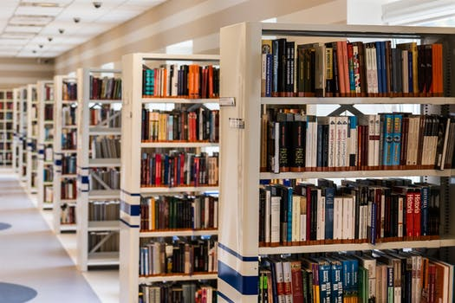
Group work

Slide 21
Acquisition
Vendors
Brodart
Ingram
Scholastic
Penworthy
Baker & Taylor
Amazon
Midwest Tape (audio and dvd)
McNaughten (lease)
Overdrive

Slide 22
Acquisitions
When to order
Automatic ordering
Pre-processing books
Budget year
Publication flow
Vendor considerations

Slide 23
Acquisitions
Find a balance between eResources and Print
You will need to determine what is best for your community
Most vendors allow 26 electronic checkouts per subscription
New lending models like Hoopla or Kanopy
Consider customer requests and checkouts per format to help determine what to purchase
Formats

Slide 24
Acquisitions
Maintain on order data
Maintain a 12 month or percentage of budget to purchase monthly
Heavy Release dates: Winter and Summer
Popular author releases
Automated purchases
Getting the book on the shelf

Slide 25
Reviews
Adult
Booklist
Publisher's Weekly
Library Journal
Kirkus
Romantic Times
NT Times bestseller list
Brodart
Baker and Taylor
Amazon

Slide 26
Reviews
YA / Children's
VOYA
Booklist
Publisher's Weekly
School Library Journal
Kirkus
Goodreads
Hornbook
Comicbookroundup.com

Slide 27
Reviews
Reviews can provide objective information about the material
Reviews are written by experts in the field, professional reviewers, and librarians
Keep policy in mind
Know the why, who especially for controversial materials
Pay attention to starred reviews

Slide 28
Reviews
Components
Strength and weaknesses
Basic Plot
Characters
Obscenity level
Author
Title
Subject

Slide 29
Cataloging and Processing
Automation
Most public libraries use automation through their Integrated Library Systems (ILS).
Keep up with maintenance and upgrades to your system
Replace system if you have outgrown it

Slide 30
Cataloging and Processing
Purpose
Careful and complete cataloging provides access to all sources of information available at the library on a particular topic, by a particular author, or in a particular format.
The better the access, the more use the collection receives and the more satisfied the customer is in their library.

Slide 31
Cataloging and Processing
Consistency
Know cataloging guidelines and then apply them consistently when cataloging. Doing so makes searching much easier and more efficient.
Be sure everyone who catalogs is aware of and follows the guidelines to ensure consistency among catalogers.

Slide 32
Cataloging and Processing
MARC record
A MARC record is a MAchine-Readable Cataloging record (Your bibliographic record).

Slide 33
Cataloging and Processing
Maintain on order data
Maintain a 12 month or percentage of budget to purchase monthly
Heavy Release dates: Winter and Summer
Popular author releases
Automated purchases
Getting the book on the shelf

Slide 34
Cataloging and Processing
Bibliographic record
Description of the item
Main entry and added entries
Subject headings
The classification of call number

Slide 35
Cataloging and Processing
MARC record

Slide 36
Cataloging and Processing
Process
Main entry and added entries
New title to bibliographic record to library catalog
Use Z39.50 to search for a record to download
If you are unable to find an item using your ILS, contact ODL to do it for you
Use ILS MARC record template and enter criteria on item into the system, barcode, and processing to get it shelf read
Or, order item from vendor and pay extra for processing

Slide 37
Cataloging and Processing
Main entry and added entries
Check author name for consistency (100 and 700 fields)
Check that the author's name in the record matches the author's name on the cover
Consistently use the same form of name for each author – it is important for authors who have multiple last names – Library of Congrass name authority
Be sure the record lists all of the creators in each title that you want to be searchable in your catalog
Tips

Slide 38
Cataloging and Processing
Check that titles within series are formatted the same way for consistencies sake and ease of searching (440 or 490 field)
Summaries are helpful for fiction books or for non-fiction books in which the title does not clearly define the content
Tips

Slide 39
Group work
Notes:
Work as a group to fill in the pieces. Go through Worksheet #2 and Potential Sources of Income; let groups decide how much they might need for their library communities. Based on their town, they should guesstimate a budget and the sources for that budget.

Slide 40
Collection Maintenance and Weeding
Assessment
Circulation
Review Collection Development policy
Plan assessment
Do a shelf read
Collate Statistics on section
Report for decision making regarding weeding, replacement or repair

Slide 41
Collection Maintenance and Weeding
Assessment
Automation reports
Copyright dates
Duplicate bibliographies
Budget report
Languages
Materials by date added
Materials usage
Reserves
Digital availability

Slide 42
Collection Maintenance and Weeding
Weeding definition
Disposing of withdrawn Items

Slide 43
Collection Maintenance and Weeding
Weeding benefits
Copyright dates
Save space
Save time of users and staff
Collection is more attractive and inviting
Ensures the collection stays current, relevant, and in good condition
Increases circulation
Customers trust information will be current and correct

Slide 44
Collection Maintenance and Weeding
Weeding excuses
Copyright dates
It takes too much time
I can't throw away books
Someone might get upset if I get rid of materials
Isn't this public property
If I toss it today, I will need it tomorrow
If I weed, I won't have enough books

Slide 45
Collection Maintenance and Weeding
Poor physical condition
Circulated in last 3 years
Inaccurate or outdated information
Condescending or biased tone
Promotes stereotypes
Appropriate reading level
Relevant to school curriculum
Weeding considerations
Interlibrary loan
Multiple copies
Newer edition
Another format available
Available in other locations
Unique information
Local or regional interest
Award winner or classic

Slide 46
Collection Maintenance and Weeding
Misleading
Ugly
Superseded
Trivial
Irrelevant
Elsewhere
MUSTIE – from CREW manual

Slide 47
Group work

Slide 48
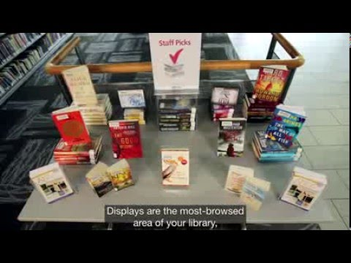
Market Your Collection

Slide 49
Market Your Collection
Select relevant topics to your community
Use clean, attractive materials
Choose themes with broad appeal
Identify branch circulation patterns
Track display use and adjust to fit community interests
Experiment and respond
Use multiple formats
Displays

Slide 50
Market Your Collection
Social media announcements
Other in-house promotion
Cross-promoting formats of same topics
Displaying themed materials during a program
Beyond Displays

Slide 51
Thank you!
This class is presented by the Public Library Academy and sponsored through a grant from IMLS.

