Slide 1
Computers and Electronic Resources
Instructor
Location
Date and time

Slide 2
Introduction
Brief course overview
Introduction, housekeeping, pre-test 10-10:30
Plans, policies and manuals 10:30-11:15
Hardware, software, and troubleshooting 11:15-12
Lunch 12-1
Internet and database searching 1-3
Apps & social media 3-3:45
Wrap-up and post-test 3:45-4:30

Slide 3
Goals
Increase your comfort level with technology
Prepare you to work with tech at your home library
Get you to think more critically about technology, the Internet, and other resources

Slide 4
ODL-IPL information
What is the Public Library Academy?
Funding and evaluation
Oklahoma Department of Libraries
Institute for Museum and Library Services and the Library Services and Technology Act
Pre- and Post-test, E-mailed evaluations
Contact information Wendy J. Noerdlinger, Continuing Education Coordinator wendy.gabrielson@libraries.ok.gov (405) 522-3322

Slide 5
Pre-test
Pre-test and post-test together measure level of achievement
Expect to not know answers for pre-test

Slide 6
Part 1: Plans, Policies, and Manuals

Slide 7
Sample technology plans
Jackson County Public Library
Wichita Public Library
Spend a few minutes looking at each of these.

Slide 8
Discussion
How do the plans differ?
Is there anything that doesn't need to be there? Is there anything that needs to be added?
Does your library have a technology plan? Do you know how to find out?
WebJunction Checklist
Make sure your plan covers end-of-life for technology

Slide 9
Internet Use Policies
How is a policy different from a plan?
Bristow
Mustang

Slide 10
Discussion
Policies should anticipate issues, not react to them.
Children’s Internet Protection Act
E-Rate
Who sets your policy? How can you make changes?

Slide 11
Manuals/Procedures
Internal documents
Can contain sensitive information (passwords, vendor contact info, etc)
Granular, step-by-step instructions for various processes and workflows
Libraries often put off writing these because they are institutional knowledge - in the head of one or more people who do the same tasks over and over. Important to get them on paper for succession and substitution purposes.

Slide 12
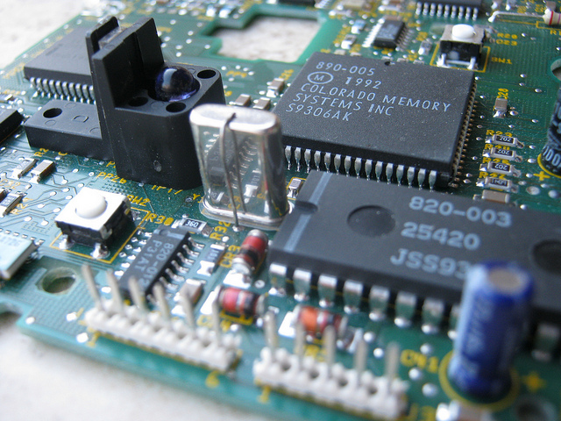
Part 2: Hardware, Software, and Troubleshooting

Slide 13
Troubleshooting Hardware
Power cycle
Check connections
Check System Tray and Task Manager
Check Storage/RAM/CPU using Performance tab
Virus and malware check

Slide 14
Troubleshooting Internet problems
Narrow down the problem. Just one PC or the whole building? Try “ping” and “ipconfig” (see handout)
Check blinking lights on PC network connector.
Trace cables back to hubs/switches/etc.
Get advice before power-cycling switches.

Slide 15
Navigating Windows
Explorer
Search in Windows 10
Common file locations: Documents, Pictures, Downloads, etc.

Slide 16
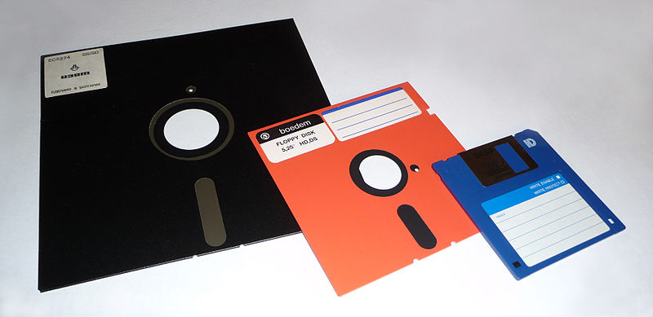
Best practices for saving files
Know where you are
Use descriptive names
Date files in YYYY-MM-DD format
Weed and organize periodically. Use subfolders.
SAVE OFTEN!!!

Slide 17
Part 3: Internet and Database Searching

Slide 18
Searching
Google is king
Alternative search engines: Bing, DuckDuckGo, Dogpile
If you're not paying for a service, you're not the customer. You're the product.

Slide 19
Getting the most out of search tools
Modes
Advanced options
Syntax

Slide 20
Evaluating websites
Fake or real?
On what are you basing your decision?

Slide 21
CRAAP criteria
Currency
Relevance
Authority
Accuracy
Purpose

Slide 22
Let’s talk about Databases

Slide 23
Easy access!!
Funding for the statewide online resources is made possible thanks to ODL’s grant from the federal Institute of Museum and Library Services.
Help your patrons discover Digital Prairie by creating a desktop shortcut. First minimize all windows. Then right click in center of the screen. Click New> Shortcut. In the text box, enter your URL or use https://digitalprairieok.net/discover/. Click Next. In the text box, enter the shortcut name. Click Finish, then test, and you’re done. Try it now!

Slide 24
Support
You should never have to use username and password in the building! If doing so, your IP address has changed since registration.
First Google 'what is my IP address' and write down that number.
Then phone EBSCO at 800-758-5995 and Britannica at 800-621-3900 ext 7160.
Or send email: support@ebsco.com and edsupport@eb.com

Slide 25
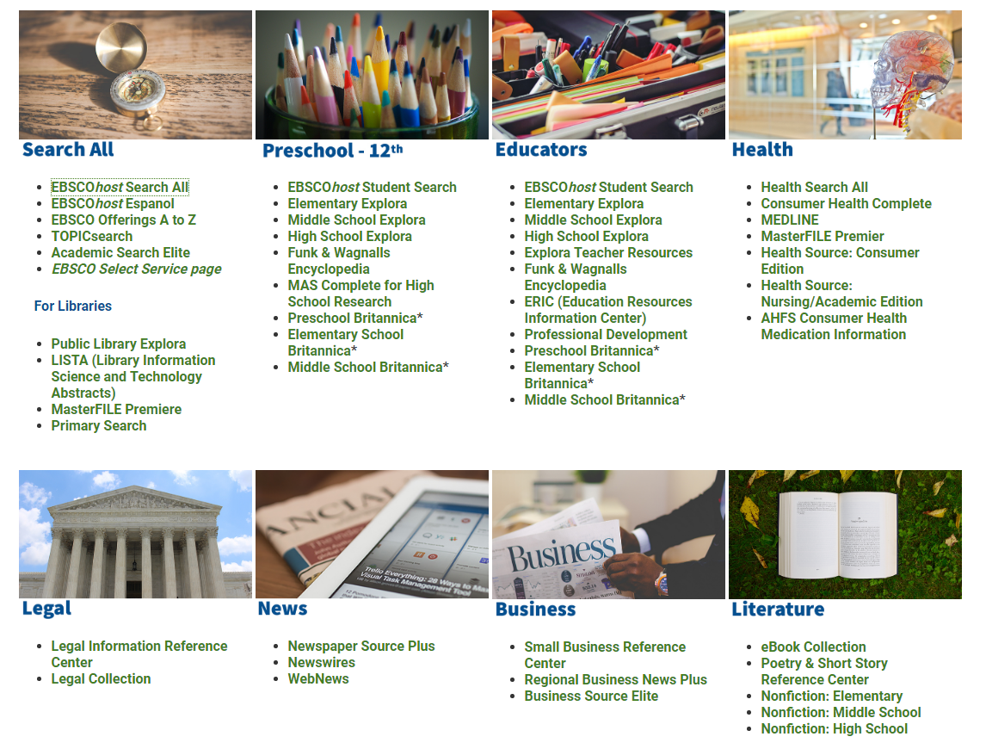
https://digitalprairieok.net/discover/

Slide 26
Even more to choose from…

Slide 27
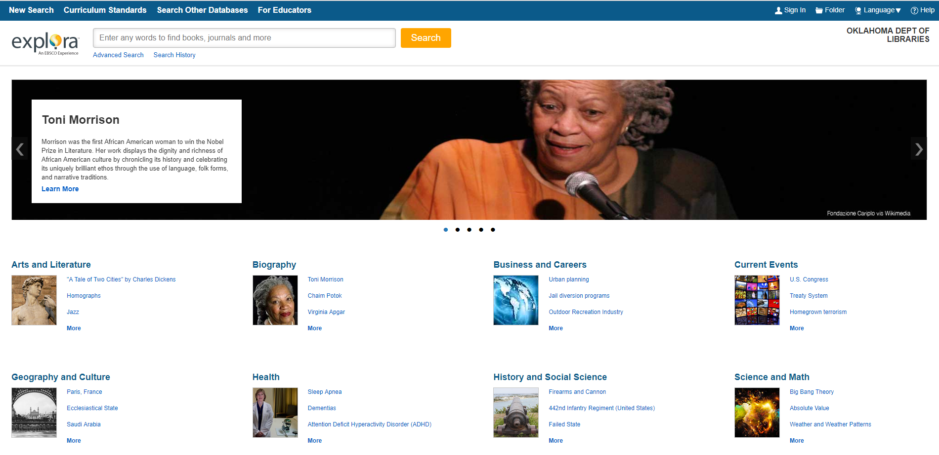
New interface
for public
libraries
or high school
students
explora has:

Slide 28
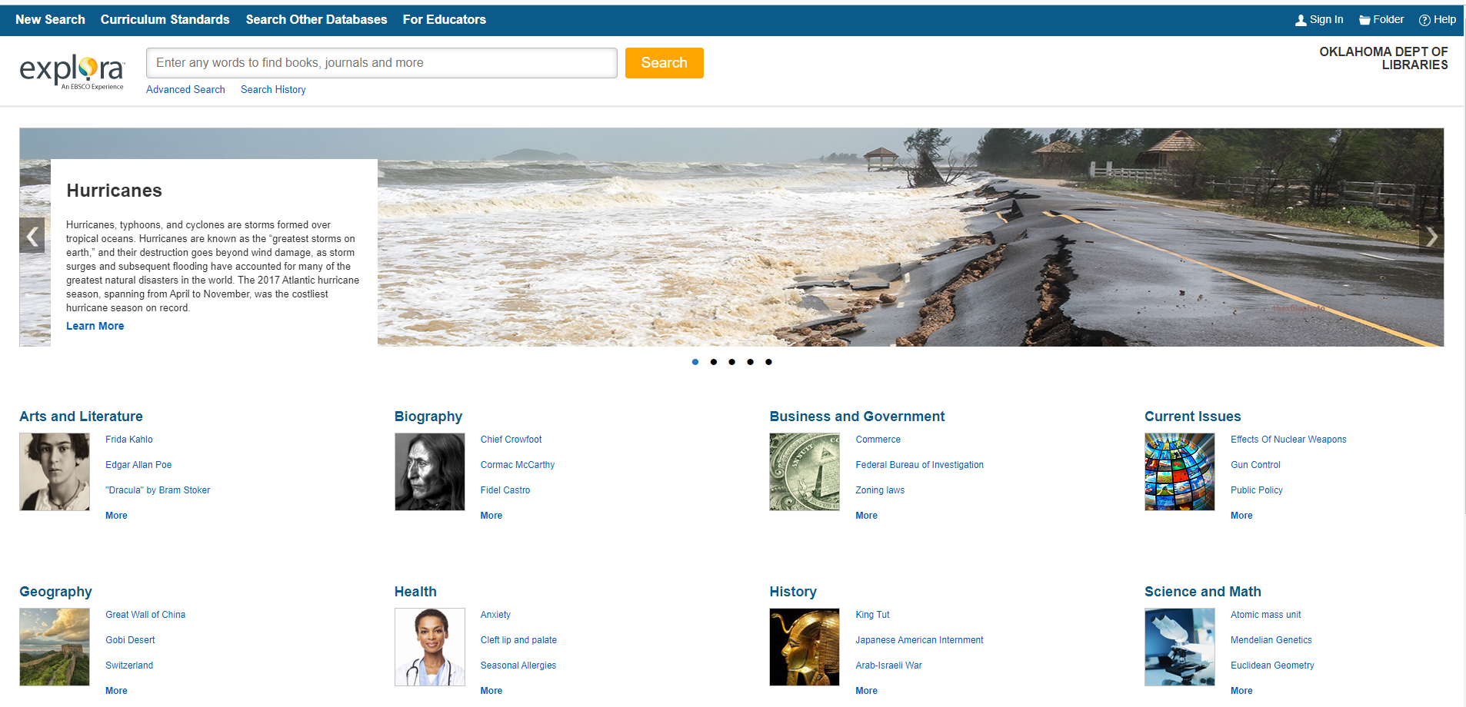
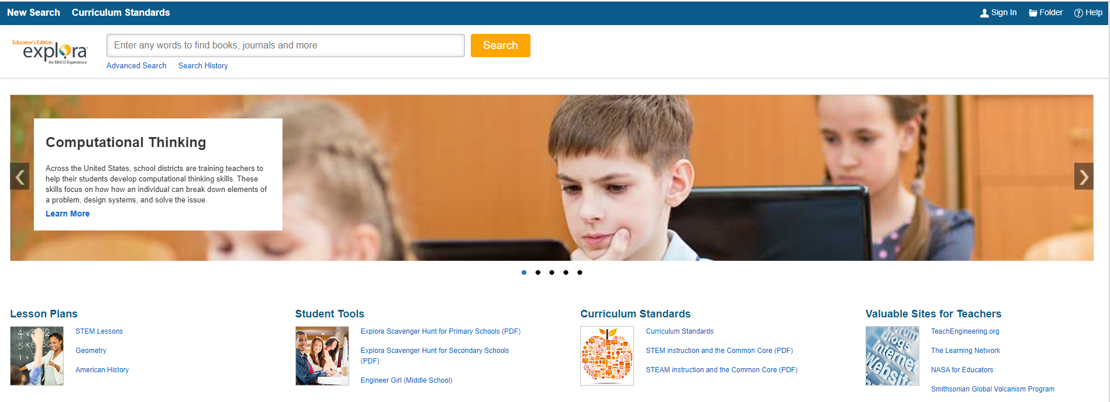
For middle school students
Teacher resources

Slide 29
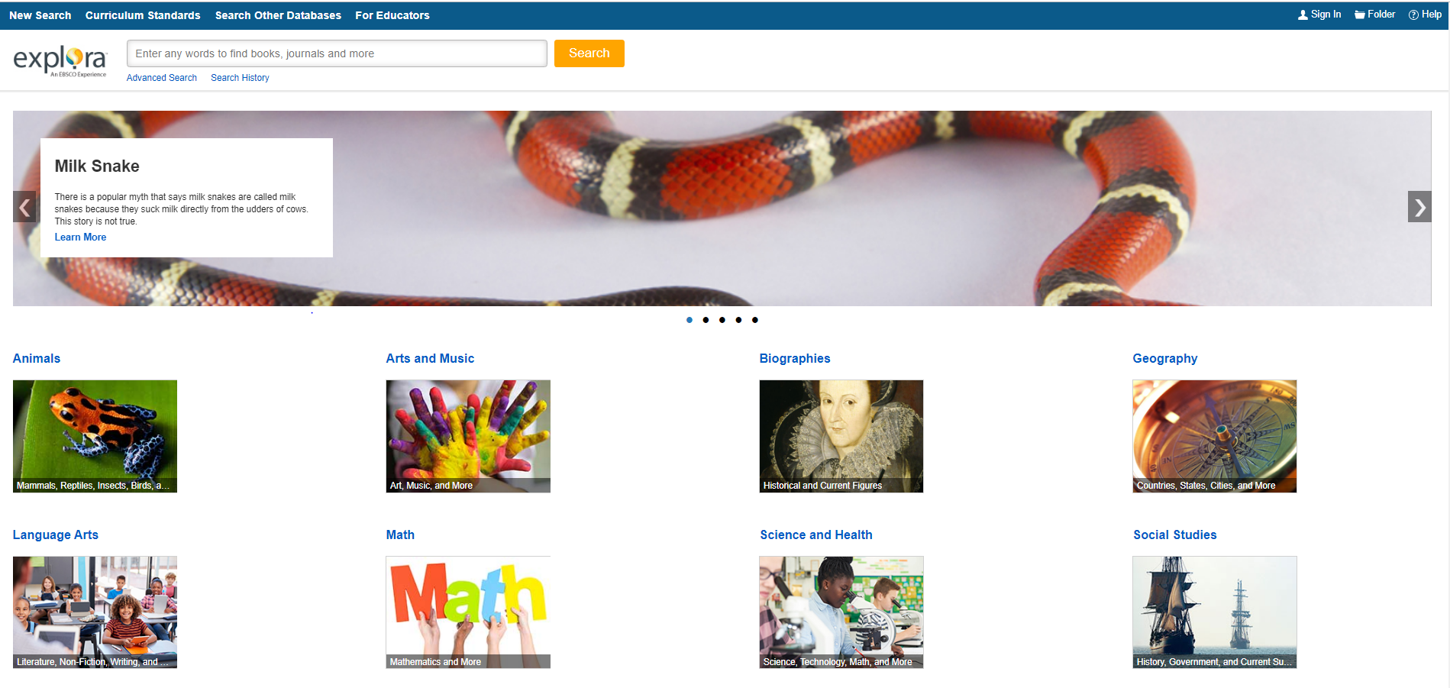
Explora Elementary Student Research: http://search.ebscohost.com/login.aspx?authtype=ip,uid&profile=ehk5 Explora Middle School Student Research: http://search.ebscohost.com/login.aspx?authtype=ip,uid&profile=src_ic Explora Public Library or High School Search: http://search.ebscohost.com/login.aspx?authtype=ip,uid&profile=ehpl Explora Educator's Edition: http://search.ebscohost.com/login.aspx?authtype=ip,uid&profile=ehed
Think desktop shortcuts…
For
elementary
students

Slide 30
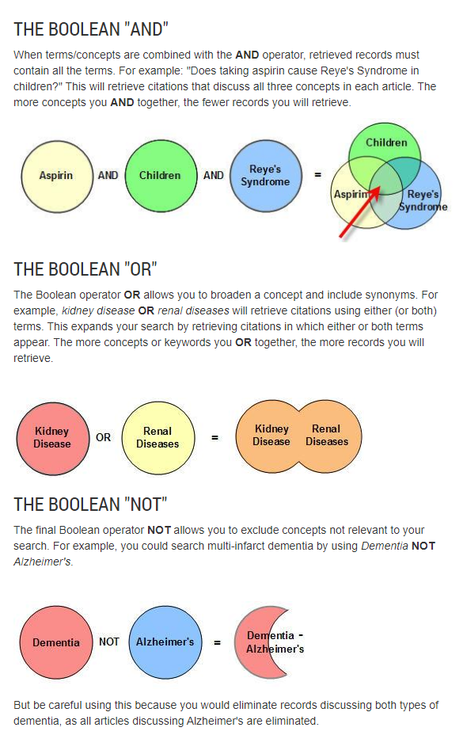
https://hsl.lib.umn.edu/biomed/help/boolean-operators
Notes:
Have your students try some searches using the Boolean terms.

Slide 31
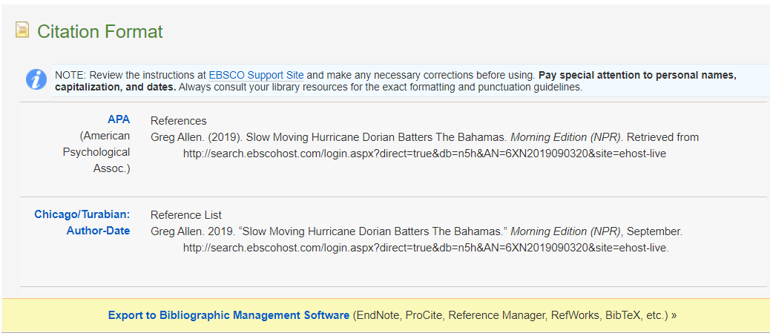
Scroll for more…

Slide 32
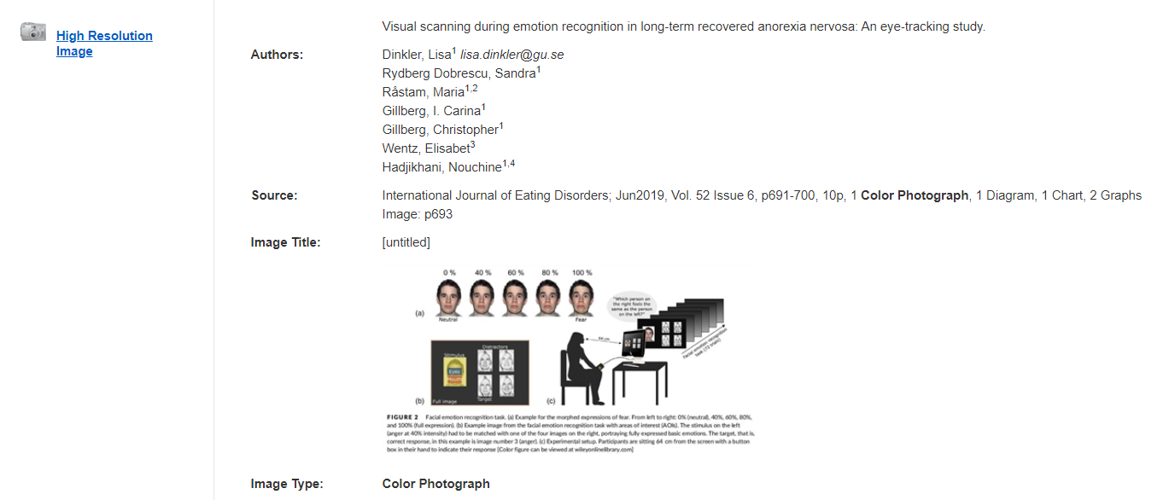
Play time!
Which one is you?
http://search.ebscohost.com/login.aspx?direct=true&db=iqv&AN=38058658&site=ehost-live

Slide 33
Dig in to EBSCO…
Masterfile – a newly married couple wants Consumer Report ratings to make the most of their small budget…

Slide 34
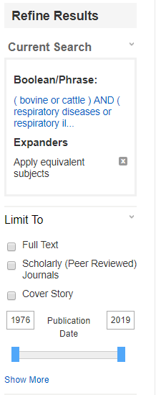
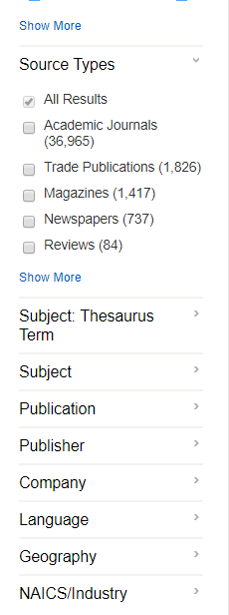
Refine results
Academic Search Elite – the vet in town needs articles
Questions?
Need it right now?
Latest research available?
Peer reviewed journal?
Send it to them in email:

Slide 35
Psychology and Behavioral Sciences Collection – mother concerned about her tween daughter
Let the auto suggest help you with search terms!

Slide 36
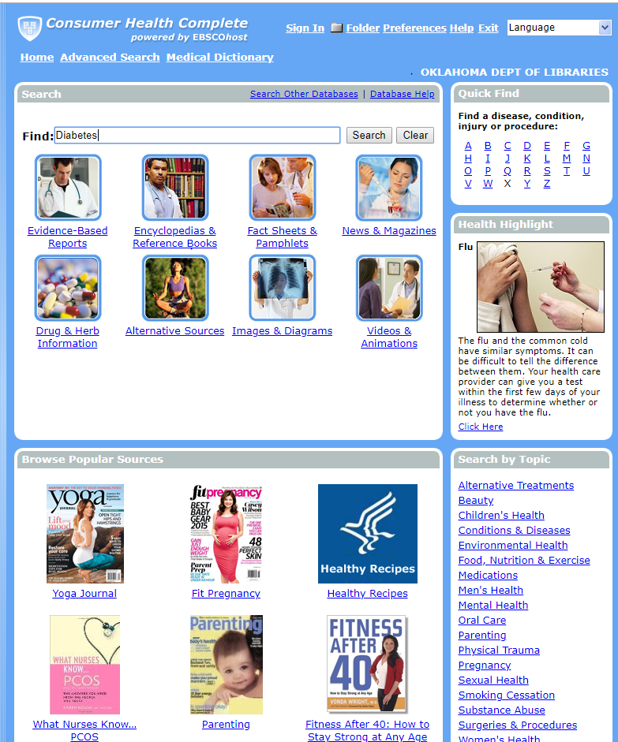
Different look but lots of info!
Consumer Health Complete – A mother needs information for a new challenge in her life…
Broad search but look at all the tabs
Use more keywords to narrow it down.

Slide 37
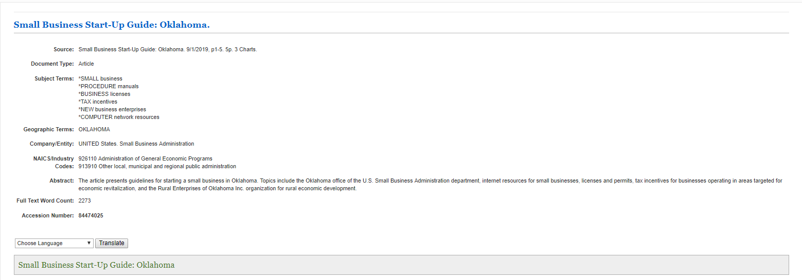
Small Business Reference Center

Slide 38
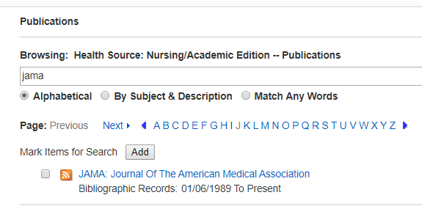
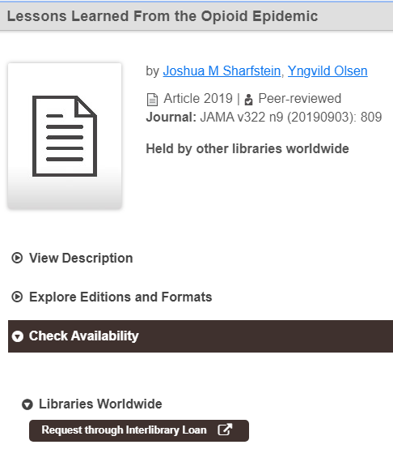
Doctor in town wants to look at newest articles in JAMA
No full text? – get articles on ILL https://statelibraryok.on.worldcat.org/discovery
Article I found:

Slide 39
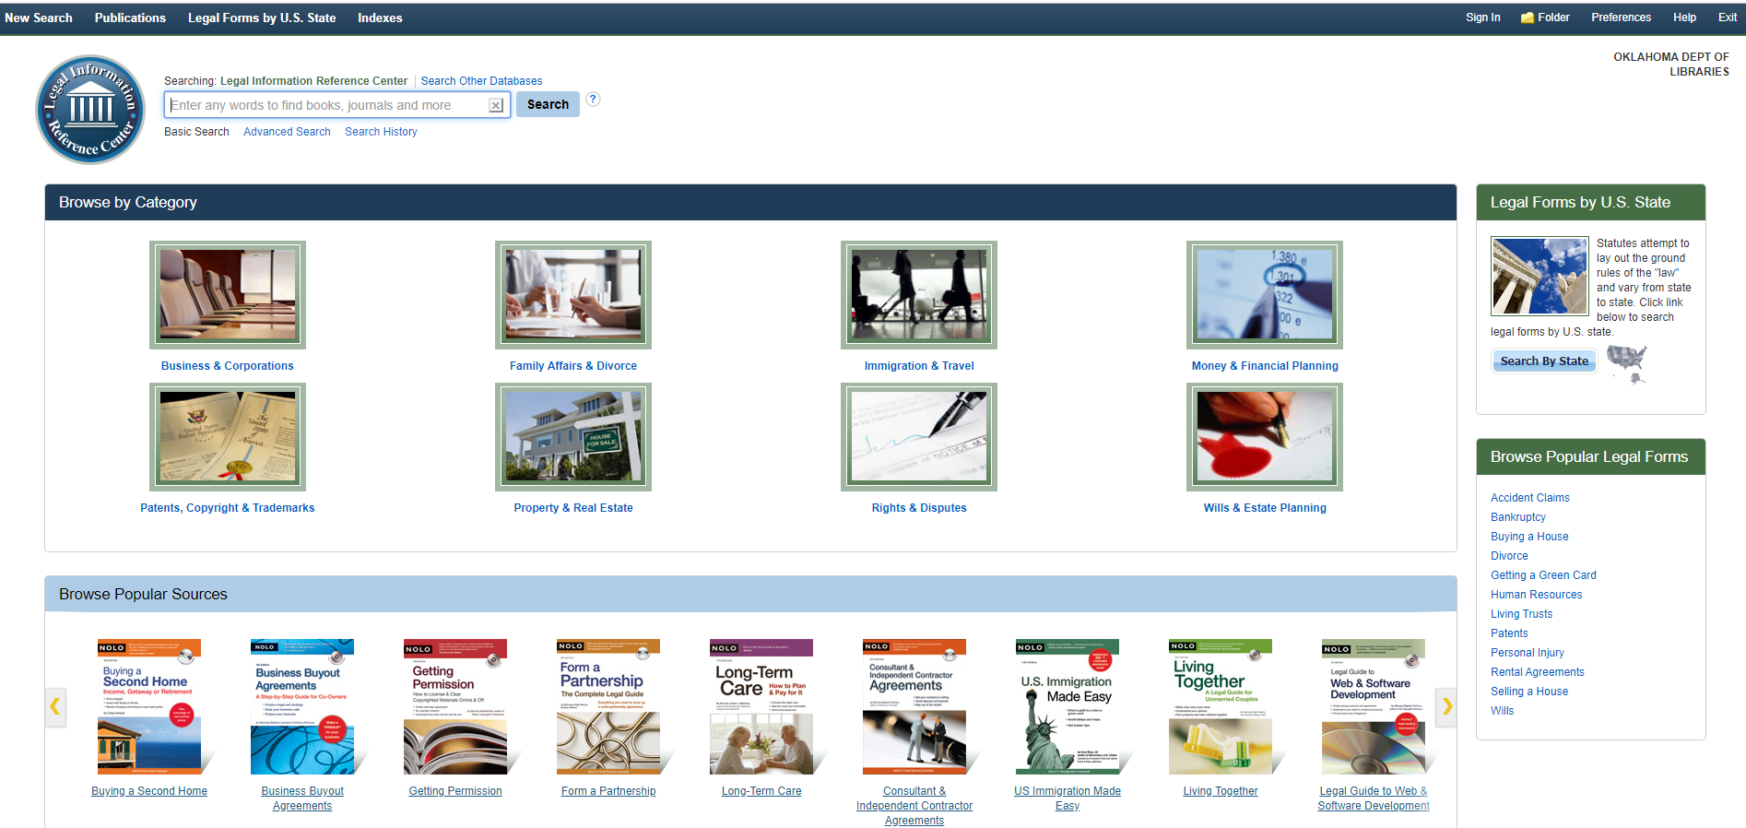
Legal Information Reference Center– a couple has questions about probate and a young man wants to know how to form a partnership

Slide 40
Home Improvement Reference Center
Husband looking at beefing up security around their house…

Slide 41
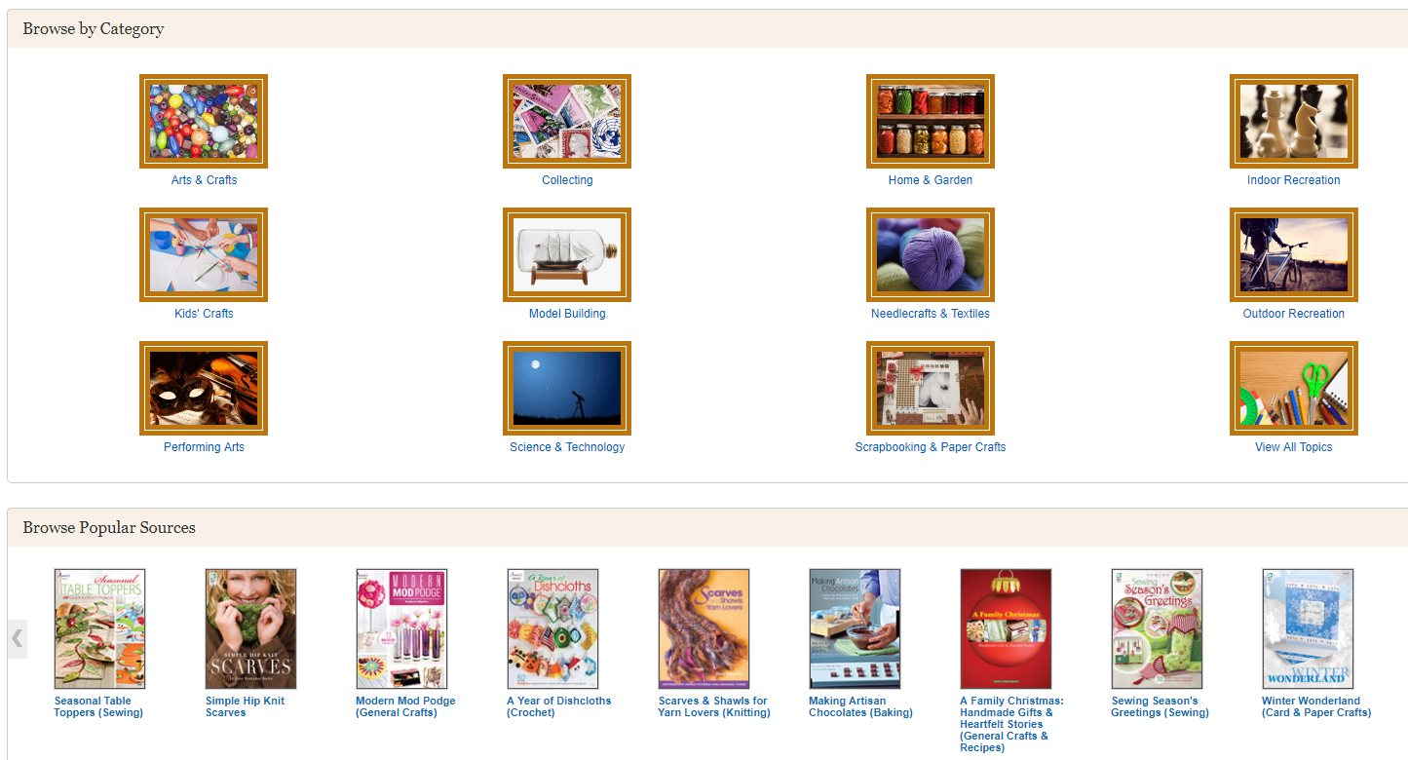
Hobbies & Crafts Reference Center – your choice!

Slide 42
EBSCO & Government Information
ERIC – teacher from the local public school is collaborating on a program with the school librarian for special needs students. They want to search the literature for others who may have done a similar project before.
*have ERIC Documents which are “unpublished” research, some dissertations and governmental “Education Reports” from agencies like the National Center for Education Statistics

Slide 43
Medline – Nursing student needs peer-reviewed research articles for course assignment.
*research studies by govt agencies and/or supported by govt grants
MAS Complete – high school student is assigned to find primary documents for US History assignment on Thomas Jefferson.
*can filter by “Primary Source Documents” when in this database alone

Slide 44
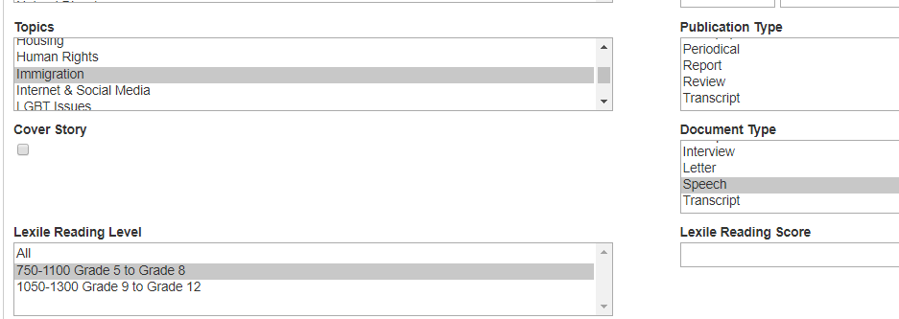
TOPICsearch – An 8th grade student is looking for the text of public speeches given on the subject of immigration.
*can filter by “Government Documents” when in this database alone

Slide 45
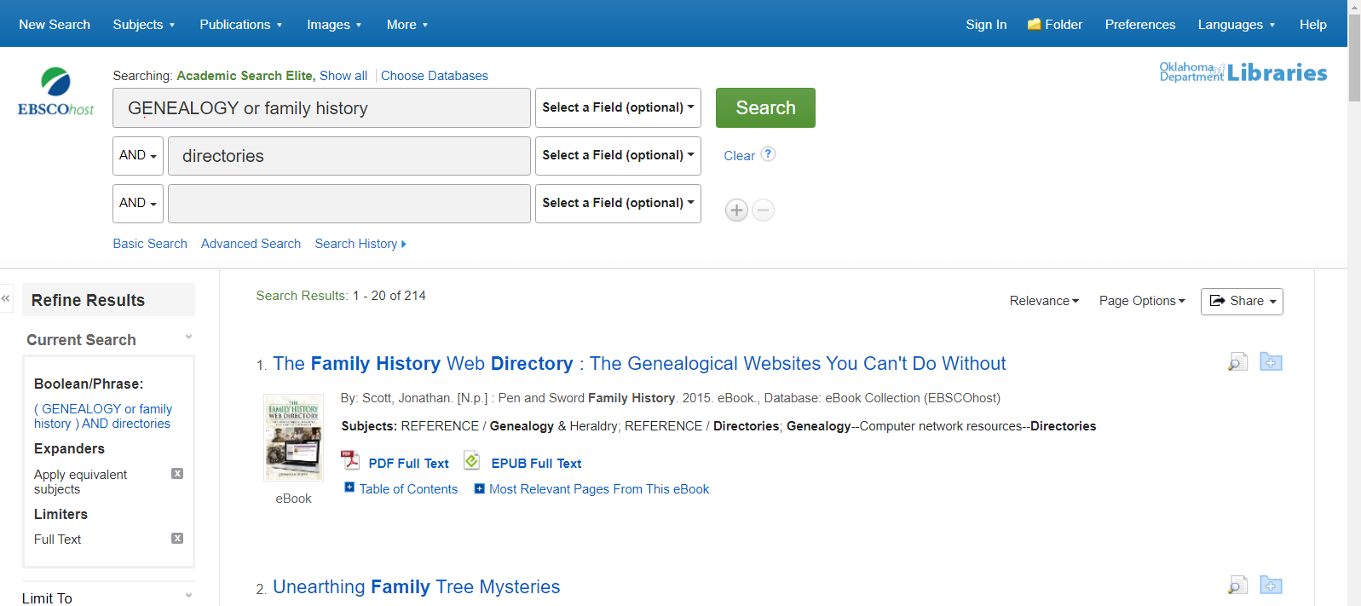
This is searching all of EBSCO…

Slide 46
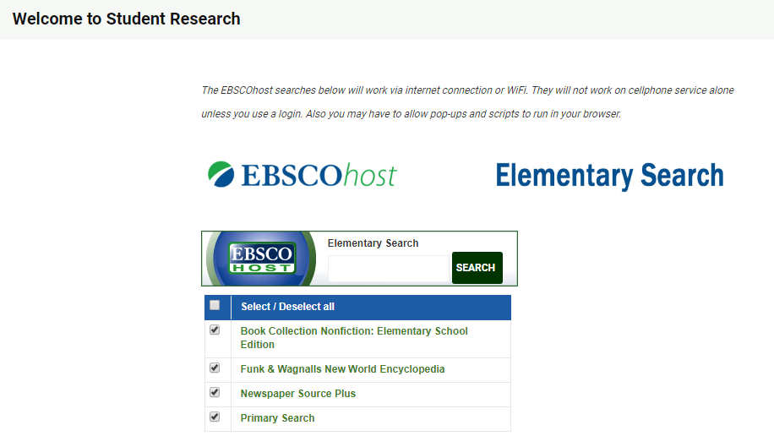
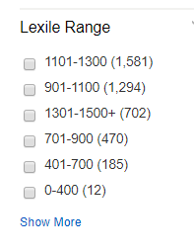
https://digitalprairieok.net/student/
From sample search

Slide 47
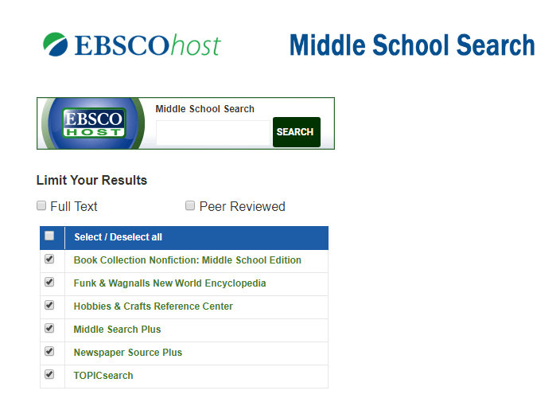
https://digitalprairieok.net/student/

Slide 48
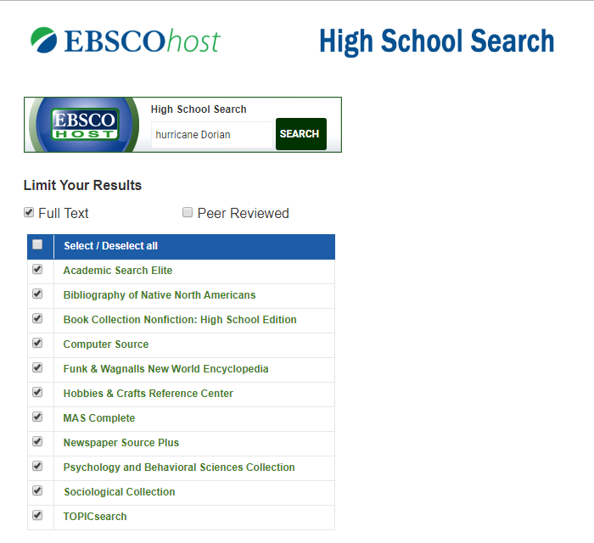
https://digitalprairieok.net/student/

Slide 49
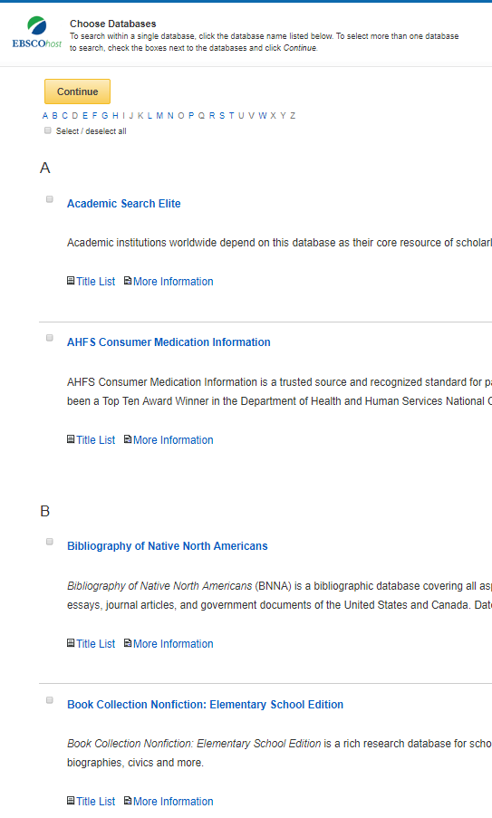
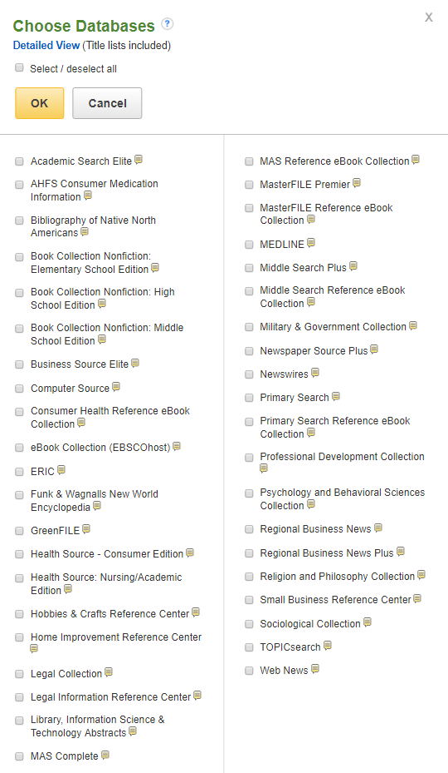
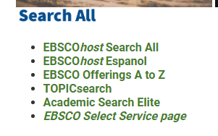
Getting there…
Grab some bookmarks!

Slide 50
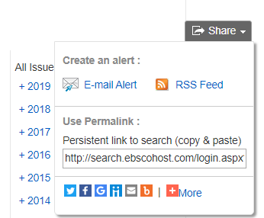
More that you might want to explore…
Folder
Journal alerts
https://digitalprairieok.net/tutorials/
and marketing materials
Also check out https://digitalprairieok.net/ for Images of Oklahoma, Confederate pension records, Ada Lois Sipuel legal case files, Oklahoma postcards, and so much more…

Slide 51
Guided Searching
Google
Google Scholar
Academic Search Elite
GreenFILE

Slide 52
Search and Find
Use the search term “fishing”
For each resource, ask:
How many results?
How are they sorted/organized? Do I have options?
What kinds of information am I finding?
Other observations

Slide 53
Part 4: Apps and Social Media

Slide 54
Apps for Mobile Devices
Goodreads
Apps tied to your LMS, e. g. Digby
Apps for e-reading, e. g. Kindle, Overdrive/Libby, hoopla
Mobile version of your library homepage

Slide 55
Social Media Marketing
Facebook, Twitter, Instagram are the basics
Use what you’re comfortable with and will use consistently.
Consider getting the youths involved: shelvers, pages, library teens. Keep control, but give them a chance to participate.

Slide 56
Social Media Marketing cont’d.
Photo permission. Remember the usage rights option in Google Image search.
Consider a social media dashboard like Hootsuite or Tweetdeck that will let you schedule posts
Blogging is old-school, but still works, especially if auto-posted to social media.

Slide 57
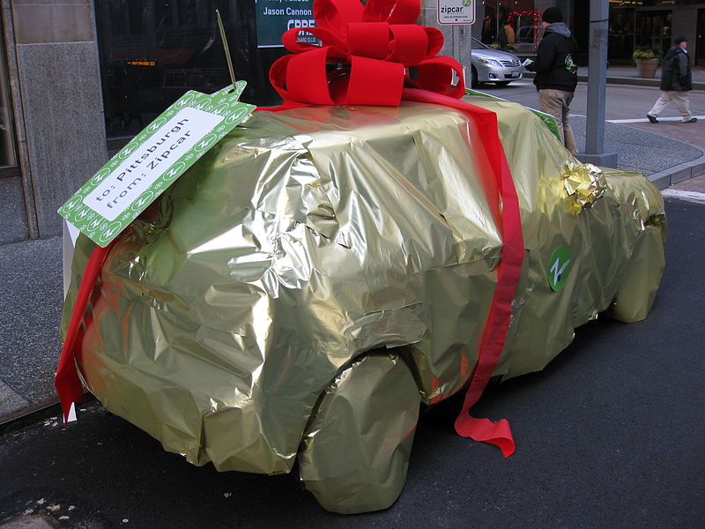
Part 5: Wrap-up

Slide 58
What to do when you get home
Find your library's technology plan, internet use policy, and tech manual, and get to know them.
Find your network equipment and learn who to contact in case of problems.
Learn what databases your library has access to. If you aren't using Digital Prairie, contact Arlene Paschel (arlene.paschel@libraries.ok.gov) if you need help.

Slide 59
Post-test
Turn in to instructor in exchange for CEU certificate, and drive safe on your way home!

