Slide 1
Services for Youth
Welcome!
This class is presented by the Public Library Academy and sponsored by a grant from IMLS.

Slide 2
Services for Youth Agenda
Early childhood development
Effective library skills that enhance development
Understanding & working with children and teens
Reader’s advisory
Educational classes & activities that promote growth
Notes:
Providing educational classes and activities that promotes growth
Services For Youth is part of the Library Certification program because it is critical that libraries serve people of all ages. Children are the future of libraries and this course will provide the information necessary for the best ways to deliver excellent library services to young customers.

Slide 3
Each of you should leave today with knowledge of:
The importance of childhood development as related to learning
The ability to offer services to the very young
Effectively communicate with children & teens
The importance of reading & how to successfully guide them through the library collection
How library services have evolved & different ways to meet educational needs

Slide 4
Today we’ll use words that describe exactly what we do and present to the public.
So, in addition to words like:
Program, we’ll use class, seminar, workshop, event, project, curricula
Storytime, we’ll use preschool class or children’s class
Reference, we’ll use research or instruction

Slide 5
Now then, growing up to be lifelong readers or why Libraries are important to children
Well, yes, we are! And here’s why:
Research shows that being exposed to reading aids in brain development, especially in the first five years of life. Let’s explore how this works in the early years.

Slide 6
Did you know?
That the brain is the only organ not fully developed at birth? It develops in the world not in the womb and it is constantly working to build connections.

Slide 7
Understanding how our brains learn is important! Brain cells connect! So, technically speaking:
A baby forms 700 neural connections per second in the first years of life
Brain cells make connections called synapses
The brain is made of brain cells called neurons

Slide 8
How connections are made and why they are critical

Slide 9
Center on the Developing Child at Harvard University:
Experiences Build Brain Architecture
Experiences build brains

Slide 10
Experiences build connections!
Early experiences physically determine how the brain is wired and create new synapses
Repetition of experiences strengthen them
Touch, sound, sight, taste and smell all build connections

Slide 11
What can babies do?
Quite a lot!
Hearing is well developed but can’t hear some low, quiet tones
Sense of touch is developed
Sight changes dramatically during first 7 months
This fits perfectly into the first stage of development!

Slide 12
During this stage, the child begins to develop:
….
Reflexes
Habits
….
Hand-eye coordination
….
Experimentation and creativity
Object permanence (knowing something exists without seeing it)
Trial and error experiments

Slide 13
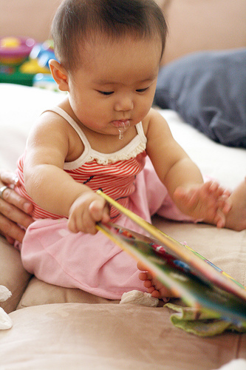
Things that give children the best start
Interaction
Touch
Safe environment
Self Esteem
Communication
Play
Music
Reading

Slide 14
What’s our role on this stage of development?
Libraries provide free, safe environments that offer repeated exposure to positive interactions during those critical years from birth to age 2.

Slide 15
Lapsit Classes for the very young
For babies and toddlers:
Singing
Reading
Moving
Playing
For parents and caregivers (show them how to):
Sing
Read
Move
Play - with their children to encourage learning and literacy

Slide 16
Lapsit basics
Sit in a circle facing each other
Every child has an adult
Short and sweet
Music is important
Rhymes and rhythm
Few short books with little text
Play time
Printed page for adults to take home

Slide 17
Songs, bounces and fingerplays

Slide 18
Songs, bounces and fingerplays

Slide 19
Creating a lapsit Class
There’s a formula!
Welcoming song
Introduction time using a name rhyme or song.
Action rhyme. Rhythm is important.
Finger play
Short book
Bounce to a song
Fingerplay
Short book
Action rhyme
Closing song
Play time!

Slide 20
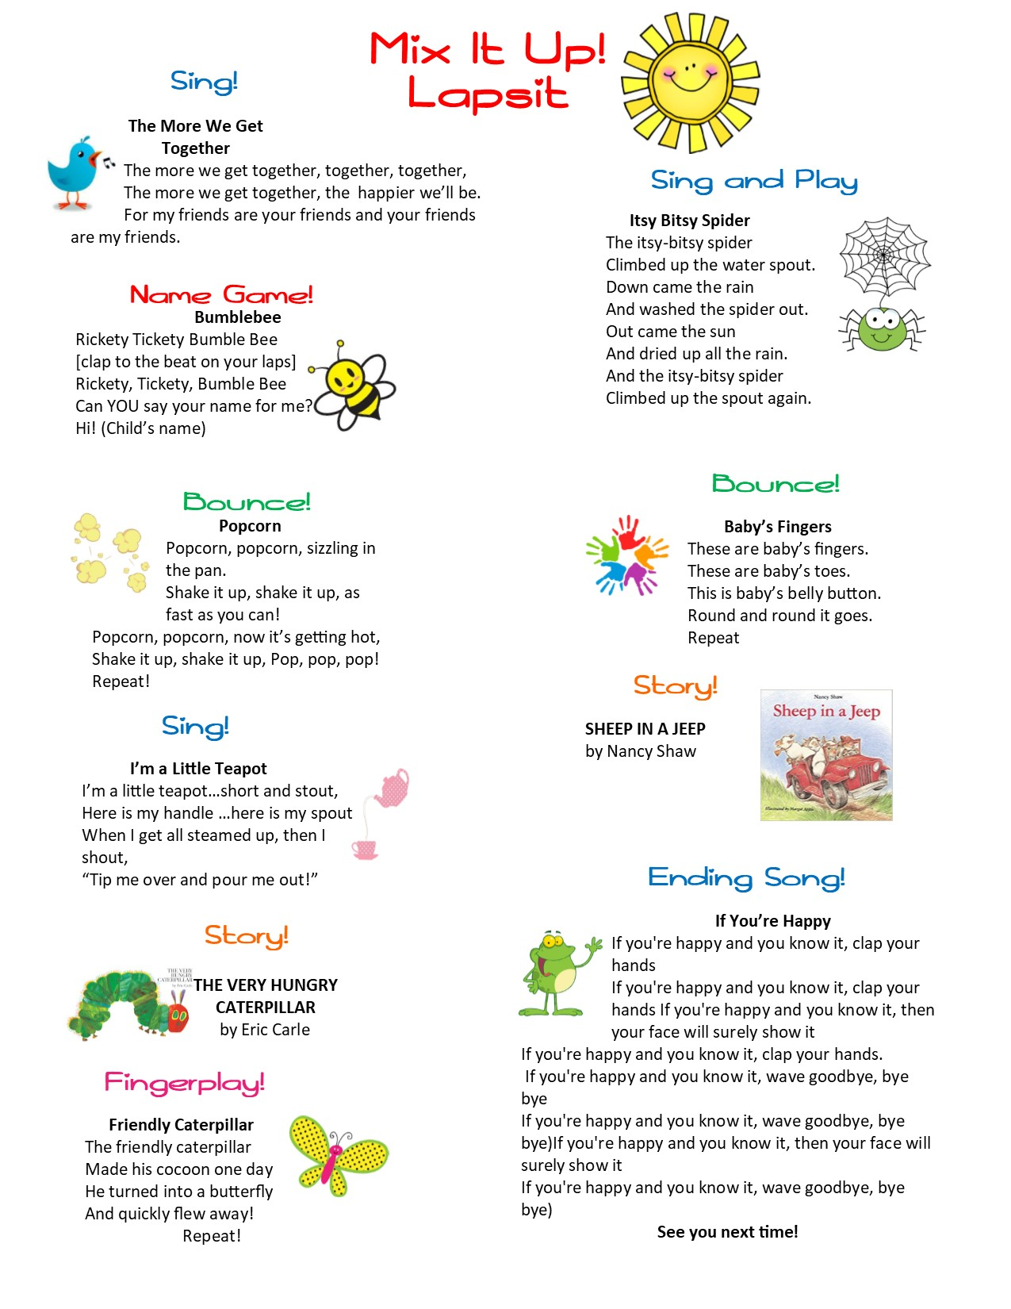

Slide 21
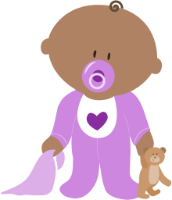
Create your own!
You have the information, so let’s try it!
Welcoming song
Introduction time using a name rhyme or song.
Action rhyme. Rhythm is important.
Finger play
Short book
Bounce to a song
Fingerplay
Short book
Action rhyme
Closing song
Play time!

Slide 22
What doesn’t work?
Class that lasts too long
Too many books and books that are too long
Flannel boards and props with pieces
Long and complicated songs
A program that lasts too long
Expecting babies and toddlers to pay attention and be quiet
Expecting toddlers to sit still
Other things?
Notes:
.

Slide 23
Ages 2 to 5 play and development is different at this age
Egocentric
Language develops – thinks in words
Play is instrumental in learning
Pretend play is crucial
Learning at a rapid rate
Often believes inanimate objects have feelings
Lacks logic

Slide 24
What’s our role at this time in a child's life?
Libraries provide preschool classes which provides the opportunity for children to develop a love of books and reading - the most fundamental skill for learning.

Slide 25
Speaking of Storytimes….
How To Plan a Children’s Class
It’s easy as 1-2-3
Choose your books
Check for length (it really matters), language, diversity, level of excitement.
Add opening and closing songs, musical instruments, flannel board, extension activities, etc.
Things to know:
Not every book works
It’s OK to stop reading a book if there’s no interest AND it’s OK to read a book again

Slide 26
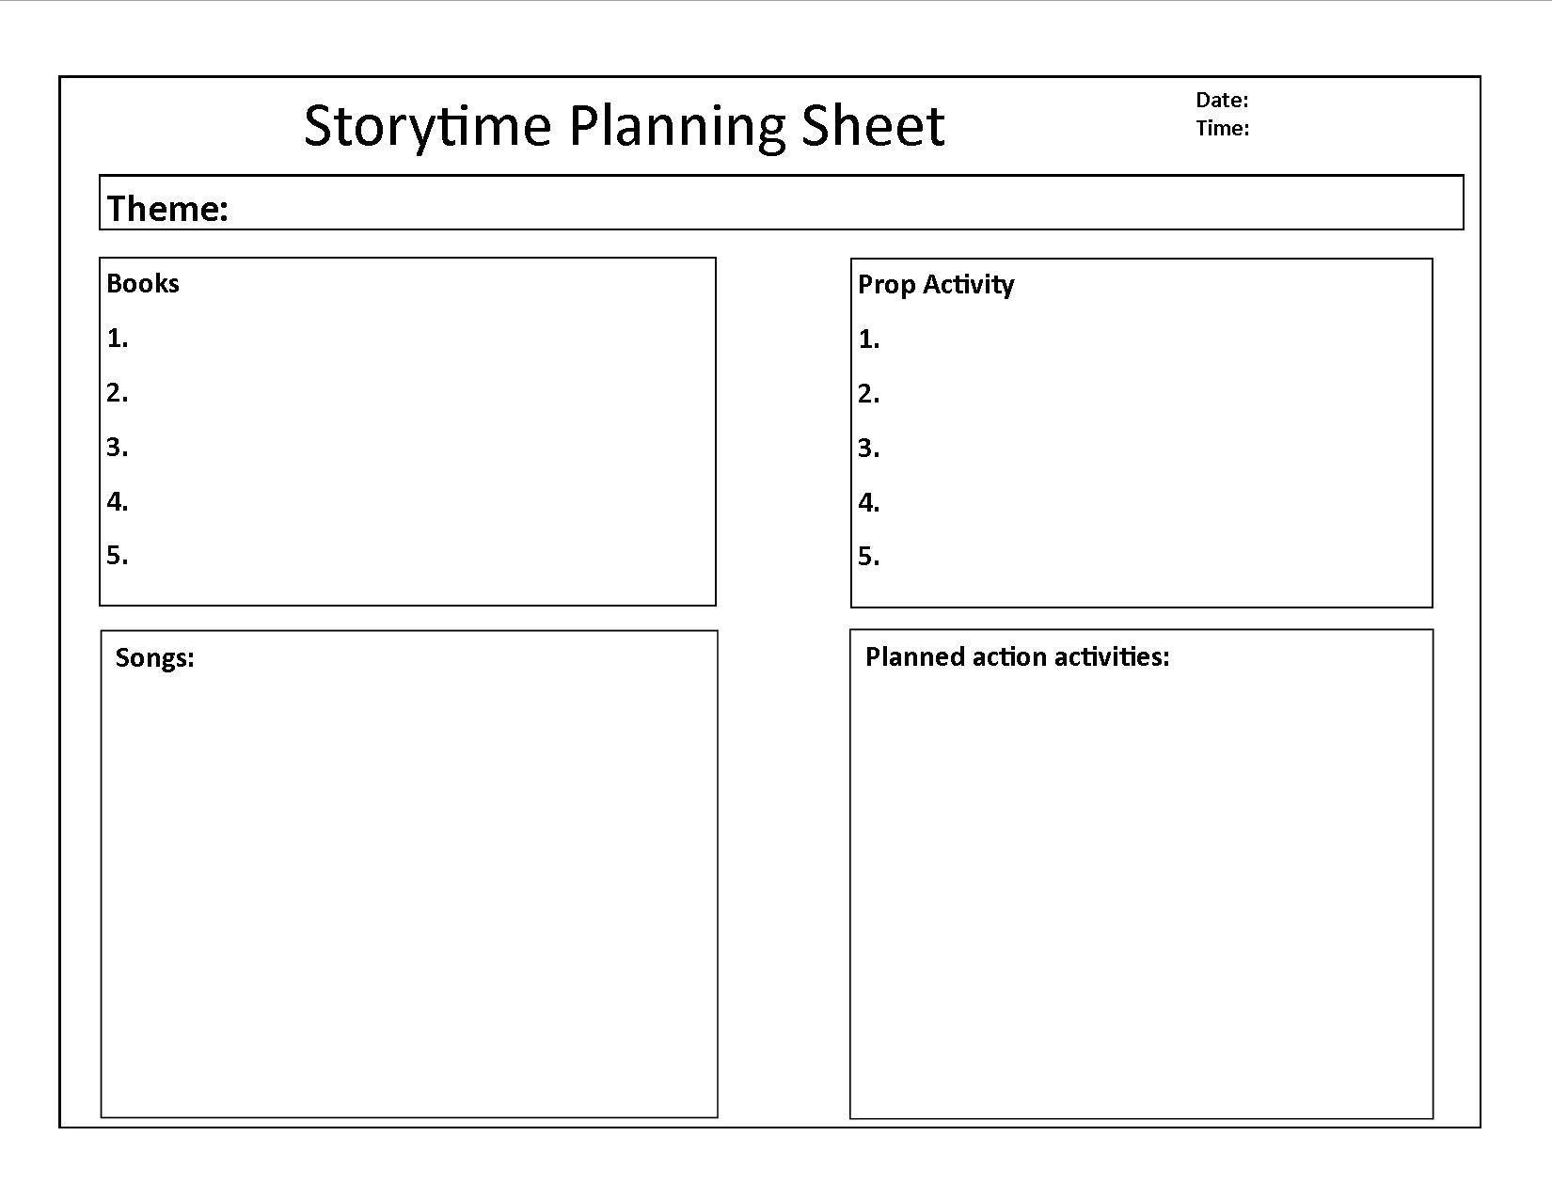
Storytime planning template

Slide 27
Development of children 6 to 12
Learn to cooperate in group settings
Develop lasting friendships & begin to handle peer pressure
Demonstrate growing independence
Use problem-solving, negotiating & compromising skills with peers
Become sensitive to what others think of them
Become self-critical & begin to self-evaluate
Can be quite sensitive & overly dramatic
Changes emotions quickly

Slide 28
What about teens?
Social changes are key!
Identity- working out who they are & where they fit in
Independence– continually growing
Responsibility– willing to take on more responsibility
New experiences– looks eagerly for this
Consequences– sometimes struggles with this
Values– sense of right and wrong is heightened
Influences– desperate for friends & highly susceptible to peer pressure
Decision-making– skills are developing

Slide 29
Serving children and teens
Getting Down to the Nitty Gritty

Slide 30
Game changer: Libraries as “Third” Places
We are:
More than lending books
Point-of-contact for so much
Navigators

Slide 31
Big Game changer for children and teens: Services – Are we doing it right?
Old school thought: give them what we think they need i.e. books, stories, ‘check ‘em out, keep ‘em quiet and see ya’ later!’
Today’s thinking: what can we provide that will enhance learning, make it fun, engage young people and make them return for more?

Slide 32
How can we make the library experience great for children and teens?
Understand their needs
Have concept of how they think
Help them understand how the library works

Slide 33
Things we need to know to offer good library experiences
Be approachable
Know how to talk to children and teens
Realize importance of reference interview
Reading levels vary!
Stay abreast of current literacy trends
Know your pop culture
Have an understanding of latest technology
Leave the library jargon behind
Have a sense of humor
LISTEN TO THEM!

Slide 34
Getting them into books and reading

Slide 35
Reader’s Advisory…….what is it ?
Customer centered library service where informed and non-judgmental library staff put books and other library materials into the hands of young readers.
Old school vs. Now
Now: Give them what they want to read!

Slide 36
Readers’ Advisory
Make the Reference Desk inviting
Listen. Be Patient & Positive
Be conscious of your body language
The 1st request may not be what they need or want
Keep asking questions
Involve children/teens as you search
Include parents…………or not.
Walk with them to find the item
Let them know your suggestions are only suggestions
Stay current with what they are reading & watching

Slide 37
What you need to know to be successful with reader’s advisory:
Genres, genres, genres!
There are genres and sub genres and more but here are a few general fiction genres:
Romance
Mystery
Fantasy
Science Fiction
Adventure

Slide 38
Genre helpers
Classic
Comics/Graphic novel
Crime/detective
Fable
Fairy tale
Fan fiction
Fantasy
Folklore
Historical fiction
Horror
Humor
Legend
Magical realism
Meta fiction (aka romantic irony)
Mystery
Mythology
Mythopoeia
Picture book
Realistic fiction
Science fiction
Short story
Suspense/thriller
Tall tale
Western

Slide 39
Name a title (or two)!
Historical Fiction
Horror
Humor
Suspense and Thriller
Classics
Dystopian
Notes:
Examples:
Historical Fiction
J- Old Yeller, Fred Gipson
Y - Book Thief, Markus Zusak
Horror
J- Goosebumps, R.L. Stine
Y- Anna Dressed in Blood, Kendare Blake
Humor
J- Dork in Disguise, Carol Gorman
Y- Carter Finally Gets It, Brent Crawford
Suspense/Thriller
J- Escape from Mr. Lemoncello's Library, Chris Grabenstein
Y- Naturals, Jennifer Lynn Barnes
Dystopia
J- City of Ember, Jeanne Duprau
Y- Hunger Games, Suzanne Collins
Classics
J- Bridge to Terabithia, Katherine Paterson
Y- To Kill a Mockingbird, Harper Lee
Adventure
J- Story Thieves, James Riley
Y- Hatchet, Gary Paulsen

Slide 40
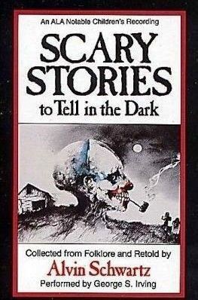
Name the genre

Slide 41
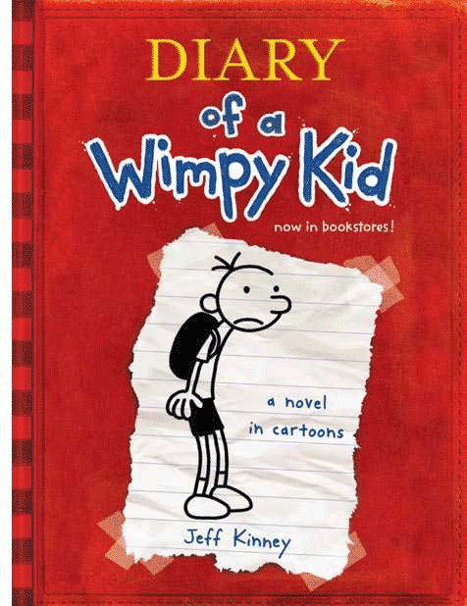

Slide 44
reader’s advisory Interview
Ask neutral & open-ended questions:
Can you tell me about a book you read recently and enjoyed?
Do you have a favorite author?
Do you like books that are true and fact-based (nonfiction) or do you like books that are created from the author’s imagination (fiction)?
What are your favorite movies?

Slide 45
More Questions- not so open ended:
What kind of characters do you like?
Do you like stories with lots of imagination?
Do you like a characters like yourself?
Do you like books with pictures or drawings?
Do you like true stories?
What other questions can we ask?

Slide 46
And finally
Now that you have an idea of what they might like, try this:
Pull books that might be of interest as you talk
Escort them to the materials
Do. Not. Point. And. Send.
Point out read-alikes
Assist with additional resources that may be helpful – booklists, bookmarks, databases, on-line groups….

Slide 47
Wait, what about research?
Basically, the same, but different. The reference
(aka research) interview.
Ask open-ended questions:
Can you tell me what you want to learn about?
Do you want to tell me how you will use this information? (in a report or term paper)
What do you know about databases?
What resources, if any, have you already used?

Slide 48
Approachability
Interest
Listen
Interview
Search
Answer
Follow-up

Slide 49
Projects, activities, Events, Classes (also known as programs): Finally!

Slide 50
Why are activities for children and teens important?
Connects young customers to new information, in new formats
It encourages children to spend increased time with books
Plays an important role in the reading achievement of children who lack access to books and other reading materials in their daily lives
Provides a role in educational development
Provides new ways to engage
Interactive programs help develop social skills
Provide access to new ideas and opportunities

Slide 51
How do I know what kids want?
Library’s free access to technology
Library as a place of making, doing and learning
Information & Community
Children’s
tech skills
Let’s talk about planning classes using technology

Slide 52
STEM: Science, Technology, Engineering & Math
Libraries are places of exploration and a natural place to support STEM
Libraries are viewed as community technology centers
Library spaces have changed to meet the needs of expanding technology making it more attainable and usable
STEAM – Science, Technology, Engineering, ART, Math
CHECK THE YOUTH SERVICES WEBPAGE FOR ALL THINGS STEM/STEAM!!!

Slide 53
OK, so now that we know about the educational opportunities out there for kids and teens…..

Slide 55
First, learn about your community!
Assess your community – find out where the kids are
What are your community resources – who can help?
What’s being offered in your community?

Slide 56
Questions to consider
What is the population of your community?
What kind of community? Rural, city, metropolitan
How large is your library service area?
How many schools are in your service area?
How many children are enrolled in the schools?
What activities are offered by the schools?
How do the children get to the library?
Do businesses or faith based organizations offer children’s activities in your area?

Slide 57
Now, Take a closer look at your community
Who lives here?
What cultures are represented?
What languages are spoken?
What holidays are celebrated?
Agencies in my local area that serve children
Economic levels in the community
Are there elected officials who would be interested to hear of the library’s work with children?

Slide 58
So, now that we know where the children are and how we can serve them,
let’s plan an event!

Slide 59
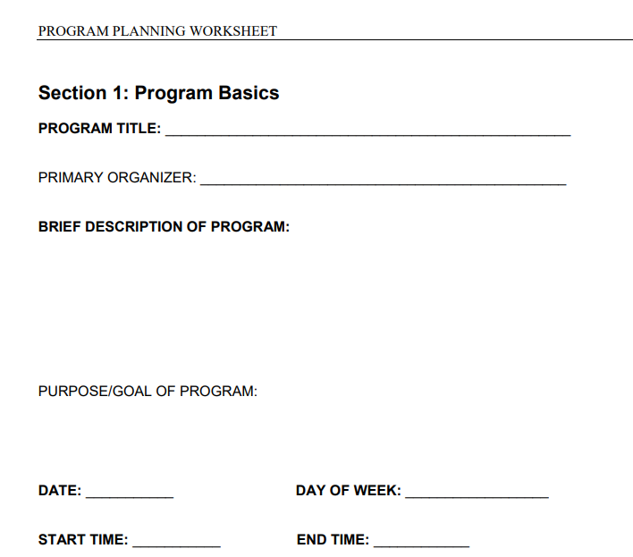
Teen Librarian Program Toolbox Checklist for successful Events

Slide 60
Lovely, Oklahoma
The sleepy town of Lovely is situated in a lower socio-economic area with little industry and is home to 2250 people. The school is the town’s largest employer. The town of Busy, a 15 minute drive from Lovely, is home to the most businesses in a two county area. There are multiple in-home daycare providers all of whom always have a waiting list. Many students that attend Lovely Schools are transfers in from other communities and 525 children in grades 1 through 12 are enrolled. Lovely Schools is the recipient of the 21st Century Learning Grant that provides after-school educational opportunities for children grades 1 through 6th grade Monday through Thursday during the school year. The Choctaw Nation provides a free 4 week summer school for children in 2nd and 3rd grades and the schools participate in the Summer Food Service program. Local Head Start programs for 3 and 4 year old children are housed within the school and those students are entitled to bus transportation.
There is a large computer lab at school but oftentimes there’s no technology teacher. The school does not provide free wireless Internet for students.
There is one local civic group in Lovely and one Boy Scout troop in Lovely.

Slide 61
Lovely public library
You work in youth services at the Lovely Public Library in Lovely, Oklahoma. There are 3 full time and one 20 hour employees. You are open from 9 am until 6 pm Monday - Friday and from 9 am until 2 pm on Saturday. Funding is stable but there isn’t a large budget for educational activities. There is a small meeting room. The Lovely Library offers standard children’s activities such as Lapsit and preschool learning classes, and other family reading times. It also hosts a Coding Class for Kids weekly and provides Summer Reading Program annually. You have the following resources to work with: arts and craft supplies, a smart TV, laptops, screen and projector, a small 3D printer, a large supply of Legos, Kinex, 2 microscopes, a medium sized telescope, and a beginners robotics kit. You have outdoor space to host events and classes in mild weather. Your supervisor is supportive of new educational ideas and willing to work with you to bring these new ideas to fruition.

Slide 62
But Seriously
So thinking about the obvious ways a library might help children and teens is fun!
A love of reading, access to information, community spaces, workshops and classes, this is what we do.
BUT, there are other things going on….
So, let’s talk Mental Health for a bit…

Slide 63
What is it & what can we Do?
Suicide
Depression
Physical Abuse
Neglect
Anxiety
Eating Disorders
Substance Abuse
Hunger

Slide 64
Child Hunger
How Libraries Can Help

Slide 65
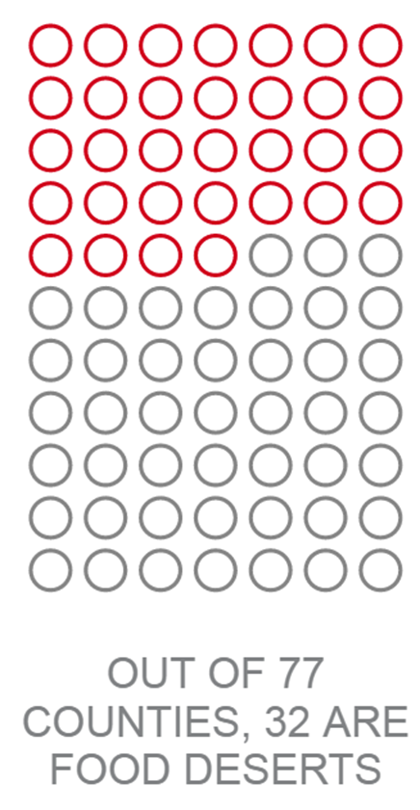
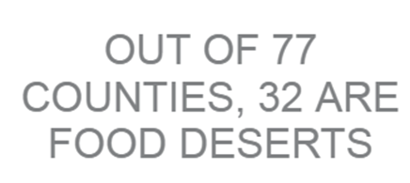
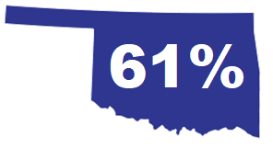
Child Hunger
425K

Slide 66
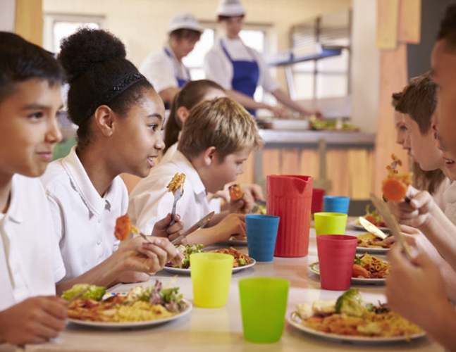
Summer Food Service Program (SFSP)
Serves <18 years
>1.5 million snacks & meals served
About 700 sites

Slide 67
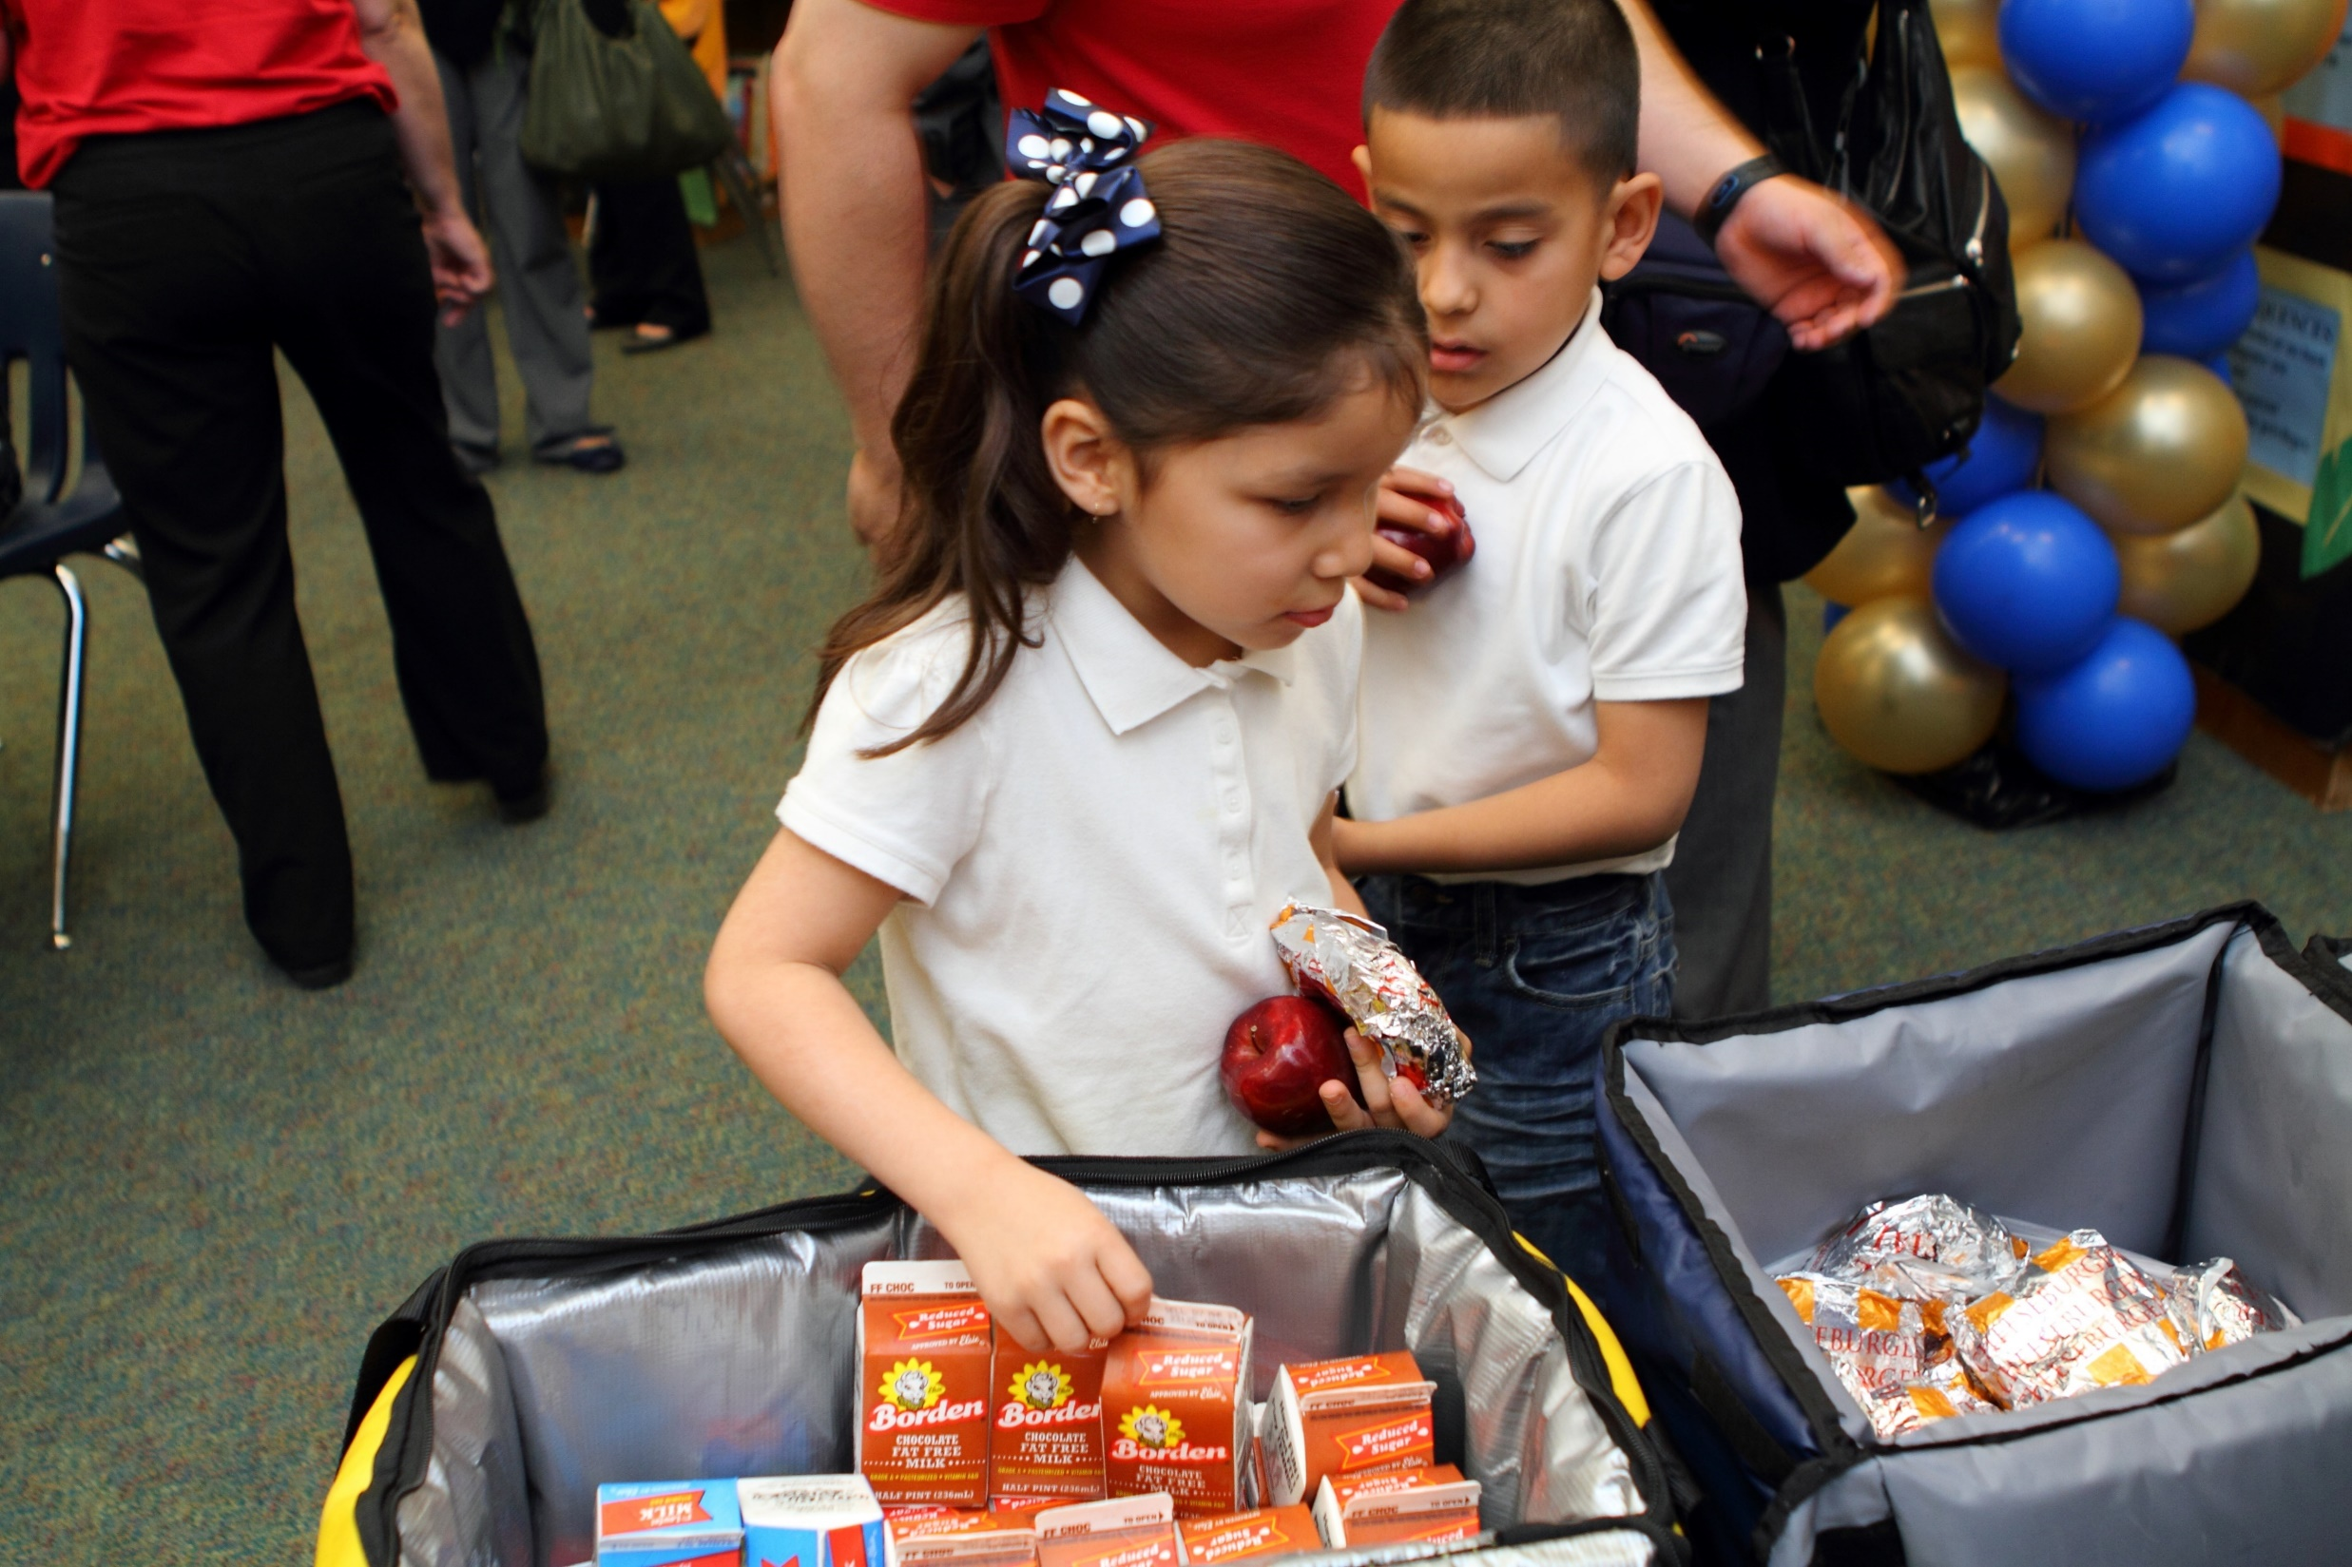
The Challenge
Underserved areas need more sponsors & sites

Slide 68
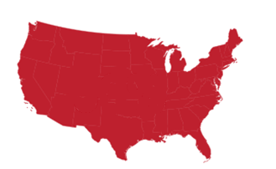
SFSP in Oklahoma 2018
51st
100:5 accessed free summer meals
Most summer school sites close by July

Slide 69
A Solution
Libraries are logical partners

Slide 70
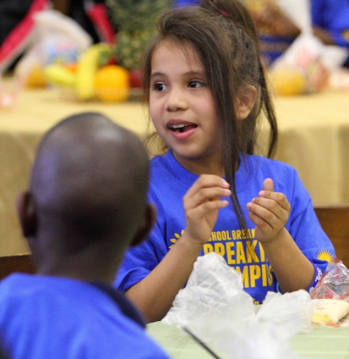
Summer Meals Partners
Promote Sites
Offer Programming
Share Services

Slide 71
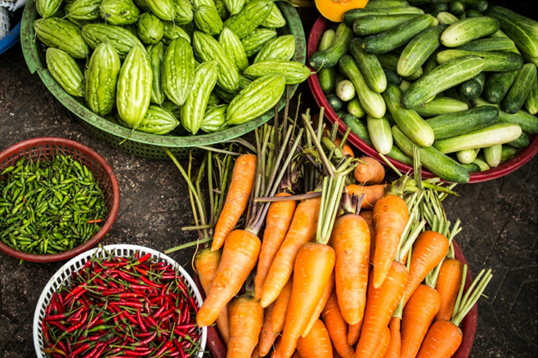
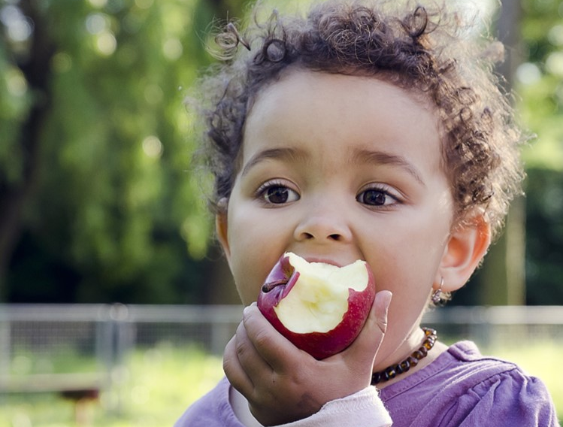
Summer Meals Site Locations
>50% of children qualify for FRPL
Schools
Apartment complexes
Community centers
Boys & Girls Clubs
WIC clinics
YMCAs
Churches
Libraries
Parks
Farmers Markets
Camps
Other?

Slide 72
Libraries can help!
Accessible
Welcoming
Retention
Low-Cost
Cross-Promotion
https://vimeo.com/258132146

Slide 73
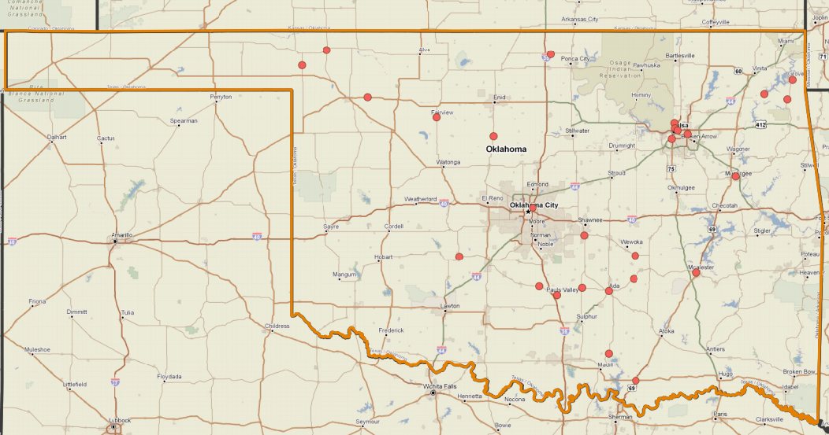
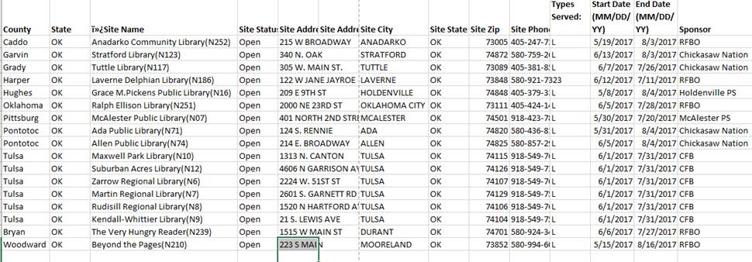
2018 Library Summer Meals Sites

Slide 74
Library Stories
"Hosting a summer nutrition program will not only boost your numbers for summer programs, but it is rewarding all in itself due to helping others and filling a need: hunger”
– Julie Pederson, Anadarko Community Library
"A success story is that kids thrive in the summer because they aren't starving. Impact is if I'm feeding them all summer and they come back in the winter.”
- Paula Nelson, Director, Allen Public Library

Slide 75
HungerFreeOK.org
Devin Schroeder
Tulsa Program Manager
Hunger Free Oklahoma
Devin.Schroeder@hungerfreeok.org
(918) 340-9082
Candace Macedo
Oklahoma City Program Manager
Hunger Free Oklahoma
Candace.Macedo@hungerfreeok.org
(405) 420-6658

Slide 76
Safe Place

Slide 77
Is your library a safe place?
What does it mean to be a safe place?
Connect with Safe Place @ 502.635.3660
TXT 4 HELP
TXT 4 HELP is a nationwide, 24-hour text-for-support service for teens in crisis.
If you’re in trouble or need help, text SAFE and your current location (address, city, state) to 4HELP (44357) for immediate help.

Slide 78
Wrapping it up!
Today we’ve talked about:
Early childhood development from a library perspective
Effective library skills that enhance development
Understanding and working with children and teens
Reader’s advisory
Planning curricula that promotes growth
How to Help

Slide 79
Wow! We’ve reached the end!
Have your questions been answered?
Is there an area that should be further discussed?

Slide 80
Thank you for attending!

